Slide 1
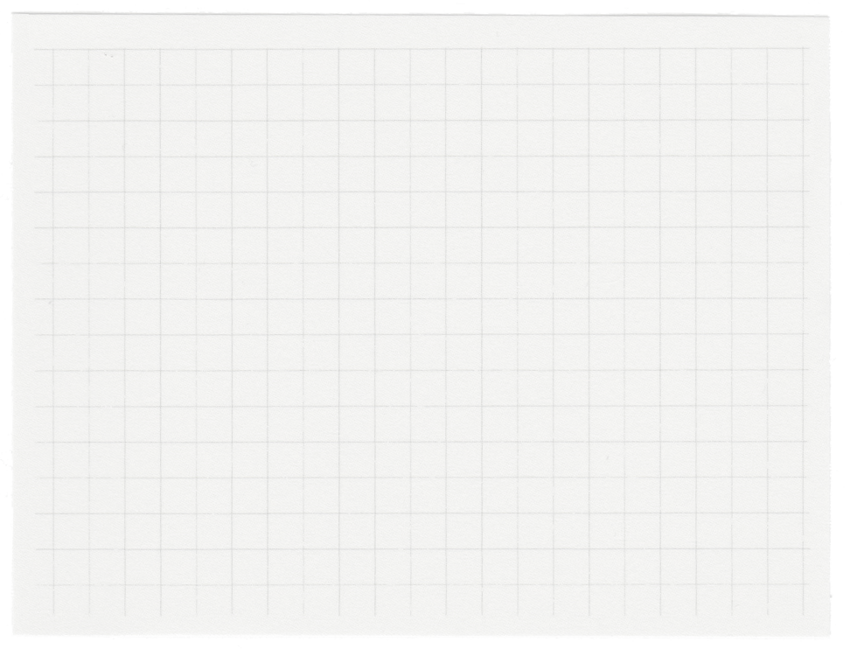
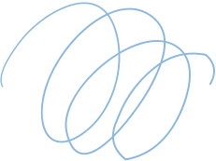
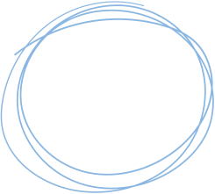

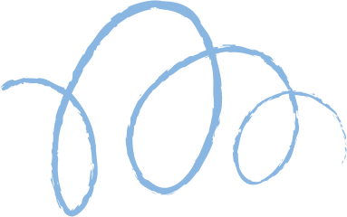










Hall Effect &
Hall Probe
Presented by Vinit Baral and Sitashma Poudel

Slide 2


Slide 3
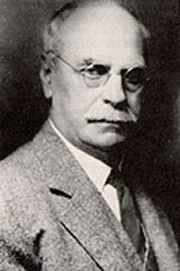
History
Edwin Hall (1879)
24 Year Old Graduate
Working on Doctoral Degree
John Hopkin’s University

Slide 4

Construction and Mechanism
Copper Strip is connected at the bottom and top with the battery.
01.
Drawing Space
A Magnetic is set up in a way that the magnetic north pole sends the field towards the magnetic south pole that in into the plane of paper.
02.
Electrons are drifted towards the left of the strip and are piled up leaving the right side of the strip to be piled up with positive charges.
03.

Slide 5

Derivation

Slide 6

Construction:
Magnetic Field Application:
When the Hall probe is placed in a magnetic field perpendicular to the direction of the current flow in the semiconductor strip, the Lorentz force acts on the moving charge carriers (usually electrons). This force causes a charge separation within the strip, leading to the generation of a voltage known as the Hall voltage.
A Hall probe consists of a thin strip of semiconductor material through which a current is passed. The semiconductor material is usually mounted on a support structure.
Hall
Probe
Measurement:
Opportunities
The Hall voltage is directly proportional to the strength of the magnetic field. By measuring the Hall voltage, the strength of the magnetic field can be determined. Some Hall probes are designed to provide information about the direction of the magnetic field as well.
Hall probes are widely used in scientific research, engineering applications, and industrial settings where precise measurements of magnetic fields are crucial. They are employed in areas such as magnetometry, quality control for magnets, and magnetic field mapping.

Slide 7

Thank you very much!
www.github.com/022neb510
https://www.linkedin.com/in/vinit-baral-165542267/
www.facebook.com/vinitbaraldai
www.Instagram.com/vinitbaral

